Slide 1
Introduction to Computers
Ball State University - CS4MS - Fall 2018

Slide 2

Computers!
Computer are made up of many parts and there are lots of way to use them! And that is what this presentation will cover.

Slide 3
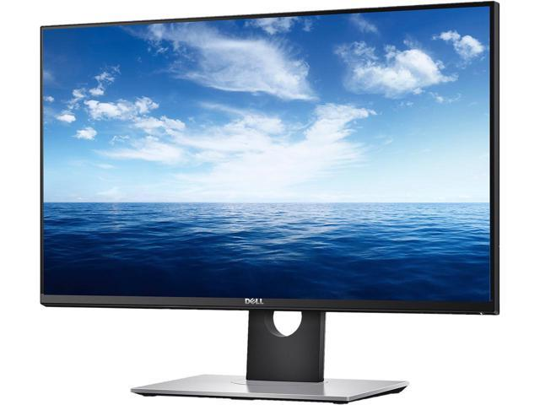

Hardware and Software
Hardware
In reference to computers, hardware are the physical objects that interact with a computer or make up a computer. Software are the programs you use with a computer. All the slides coming up will tell you whether it is hardware or software. Over to the side is an example of each.
Software

Slide 4
The Monitor-Hardware
The monitor lets you see what you are doing and access your work. This is an important part because otherwise we wouldn’t be able to know what the computer is doing.

Slide 5
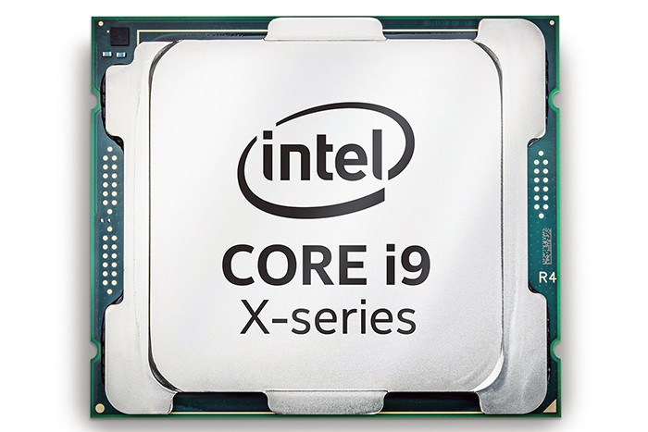
The CPU-Hardware
The CPU is like the brains of the computer and it is what is needed for a computer to run.

Slide 6
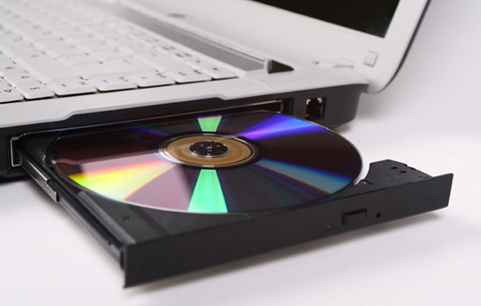
CD-ROM Disk Drive-Hardware
You can insert a CD into your computer for storage. CD’s are a form of storage that can hold 5 Gigabytes. They can read movies, music, and applications.

Slide 7
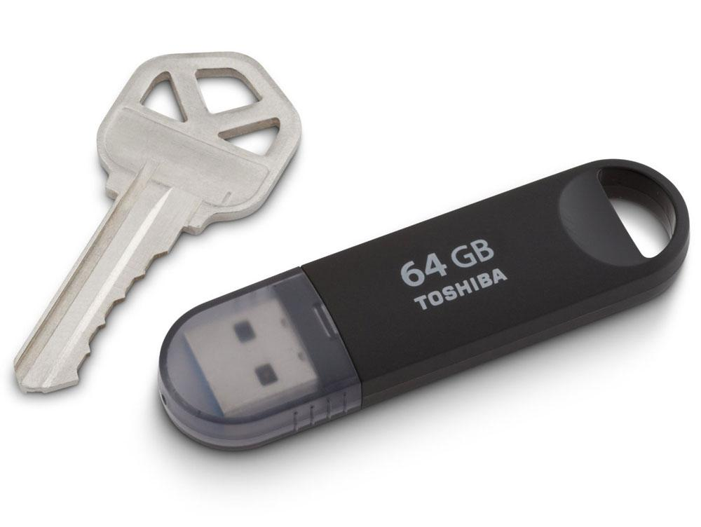
Flash Drive-Hardware
A flash drive/thumb drive/... is a storage device the size of a key. They can hold up to 64 gigabytes of storage.

Slide 8
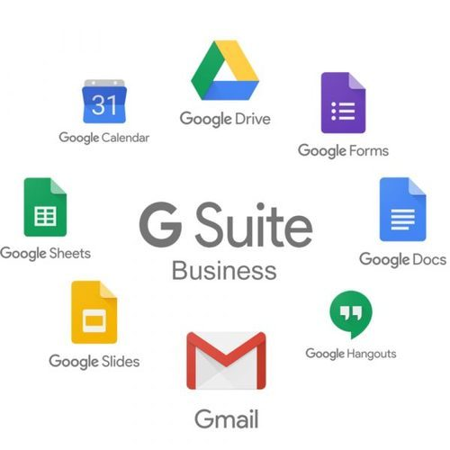
Google Suite-Software
The Google Suite is a program by Google that allows you to type documents with Google Docs, create spreadsheets with Google Sheets, present slides with Google Slides, read email with Gmail, create calendar notifications using Google Calendar, chat with friends with Google Hangouts and access all you need in one place using Google Drive. The Google Suites’ biggest competitor is the Microsoft Office Suite.

Slide 9

Games-Software
You can play games on your computer as well. Currently the most popular game to play is Fortnite (pictured right) produced by Epic Games. If your computer can run it, you can play it.

Slide 10
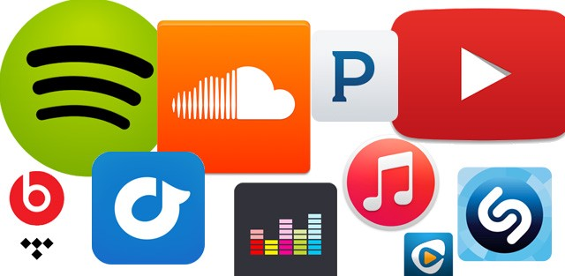
Streaming Services-Software
You can stream things on your computer as well. Music, tv shows, and movies are all things you can stream. Apps like Spotify, Apple Music, Netflix, Hulu, and Amazon Prime allow you to do this.

